Slide 1
Agent Path Planning
and Tracking
-- Application of HJ Reachability
Group 14
Yuhao Chen Shebo Jia YaChe Shih Xiaoran Zha

Slide 2
Introduction
The abilities to reach the destination and avoid possible obstacles that exist on the path are basic requirements to develop a successful autonomous system.
In our project, we designed a simplified agent path planning model, in order to drive the agent from the initial position to the termination set and dodge the obstacles on the path.
Methods of path planning and different controllers are adapted to reach our goal.

Slide 3
Objective
Avoid known static obstacle, unknown static obstacle, and known dynamic obstacle
Path plan to avoid static obstacles (RRT Star)
Path track to avoid dynamic obstacles and unknown static obstacles
Hamilton-Jacobi (safe) controller for collision avoidance tracking
PID (tracking) controller for tracking without collision

Slide 4
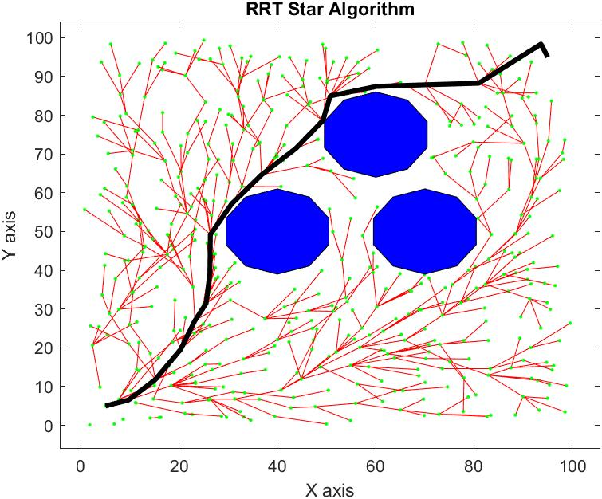
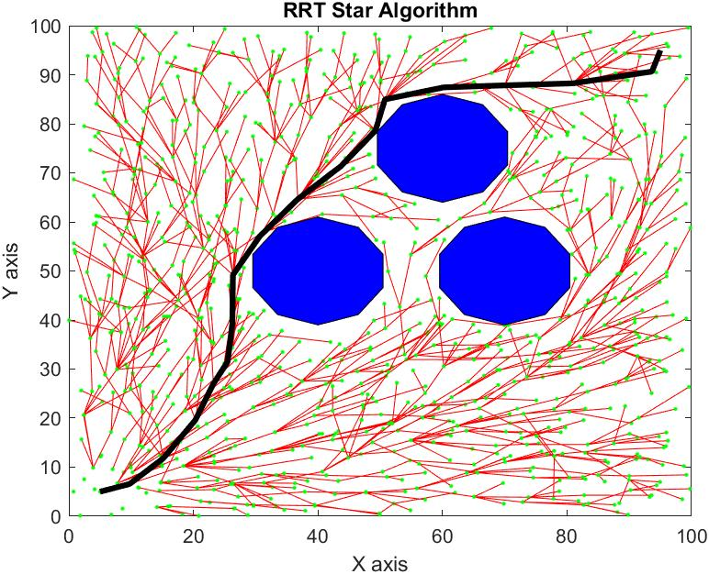
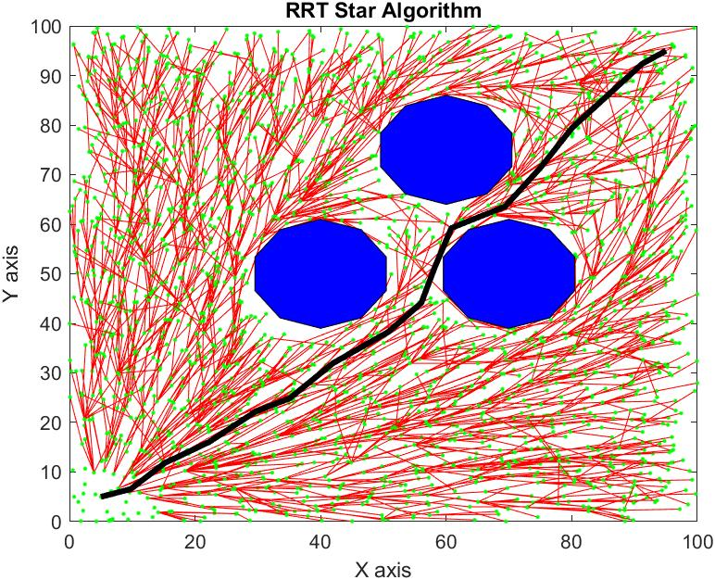
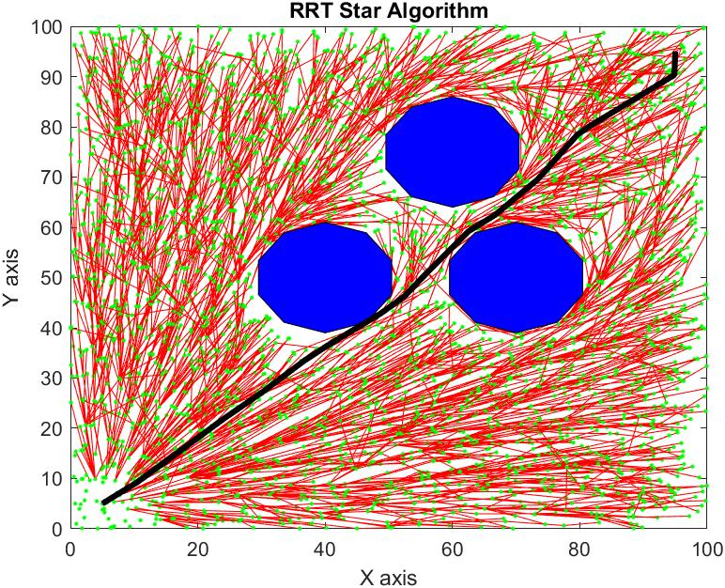
RRT Star Path Planning
· : Random points generated
—— : Vertex
: Obstacle (Unsafe set)
—— : Path Planned
...
As more and more vertices created
Notes:
RRT is an efficient way to explore the potential paths in the space and navigates the agent move from its initial node to the the destination. RRT grows a tree rooted at a start node and detects potential path through its branches.
The points marked in green are randomly generated and connected to the closest available node. Those connections called vertex, which is marked in red line. As long as a vertex is created, a check must be operated to verify the vertex lies outside of an obstacle (Unsafe set). From its hundreds, thousands possible routes, this modified algorithm figures out the shortest path marked in black.
As we see, when more and more vertices are created, there are more potential path to reach the target, and the black line is changes and shorten as well, which means a better and shorter path is found.

Slide 5

Without Collision: Tracking PID Controller
Cut our desired (planning) path into several segments with minor starting point and target set.
x
x
x
x
x
X : Starting point
: target set
: agent
x
x
x
X
x
X
x
x

Slide 6
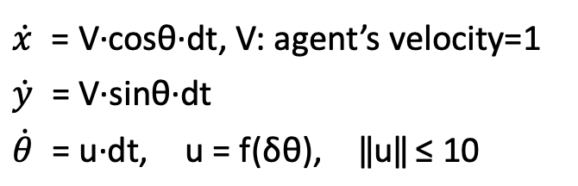

Without Collision: Tracking PID Controller
X
X
X : Starting point
: target set
: planning path
: PID controlled path
X
X
X
Notes:
When our agent arrives a start point, the system switch into safety controller. If there is no unknown object or dynamic obstacle at current start point, and neither in our target set, we apply PID controller in this segment.
V is our agent’s velocity, which we set 1,and u is obtained by our PID controller.
If there is collision at start point or will collide in the target set, we switch into HJ PDE solver, which will be mentioned after this. To prevent discontinuous when switching between these two controllers, we bound the value of u by 10, this can prevent non realistic turning in our simulation.
As we can see from this page, our PID controller is respect to delta theta. Therefore, our agent can almost follow our desired path but with small deviation.

Slide 7
With Collision: Hamilton-Jacobi PDE solver
Unknown static or Dynamic obstacles are detected
Switch to Safety Controller
Initial position:
Current location
Target set:
The nearest reference point outside twice the safety range
Running time:
Approximation of the time period from the initial position to the target set
Obstacles:
The collided obstacles around the initial position
The region is calculated by distance, so it is likely to contain the obstacles that is behind the agent

Slide 8
With Collision: Hamilton-Jacobi PDE solver
The value of the solution
Less or equal to zero:
Find the optimal trajectory
Larger than zero:
Extended the running time: Looking for a solution that need a longer time
Setting the further target set: Solving another PDE
Trajectory and controller switch:
Switch back to the Tracking controller at the end of the trajectory, and track the next reference point by rotating at the minimum angle within a certain range

Slide 9

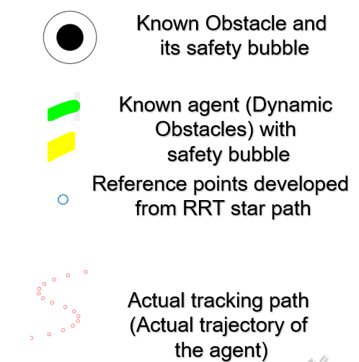
Testing Example: without unknown obstacle

Slide 10
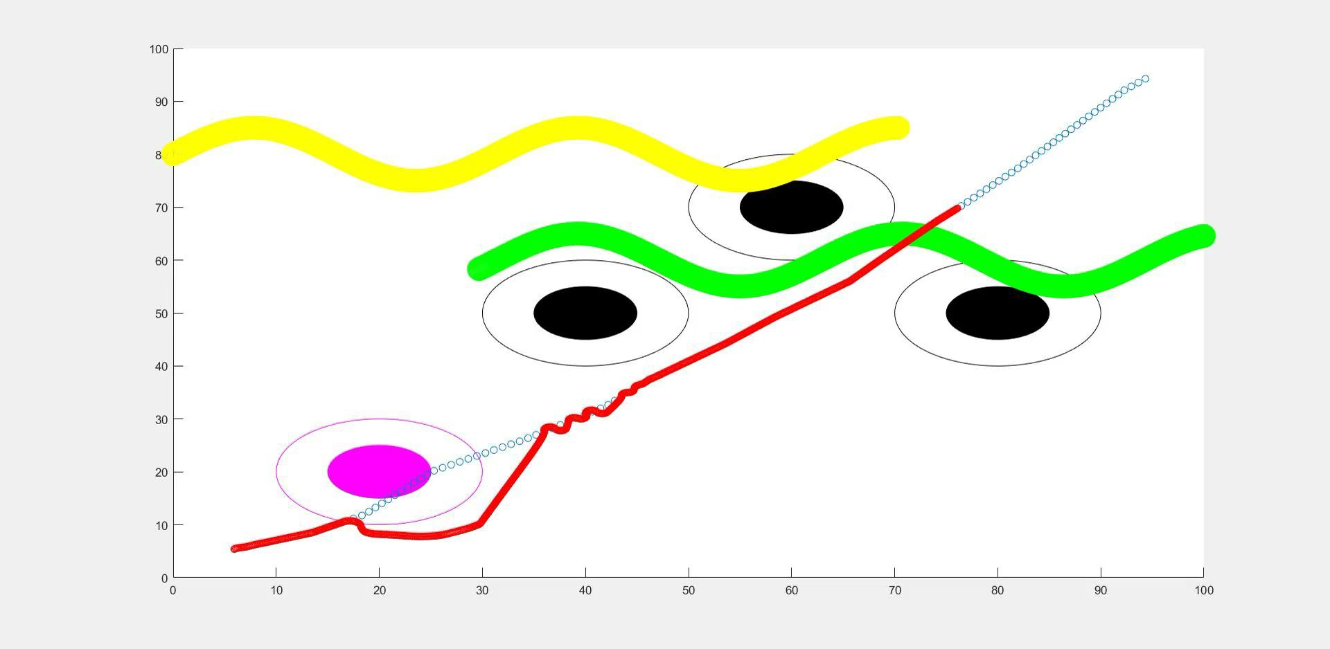
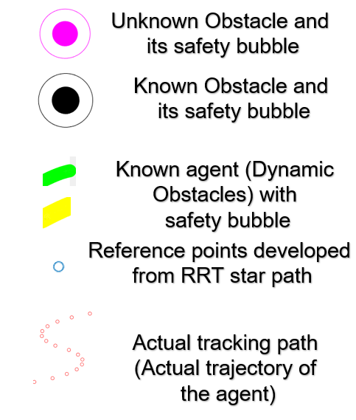
Testing Example: with unknown obstacle

Slide 11
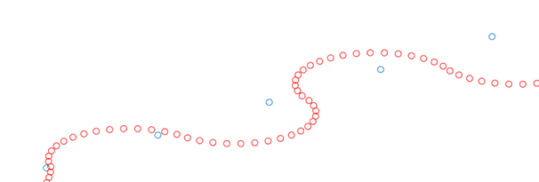
Testing Examples
● Zoom in for the tracking path

Slide 12
Conclusion
RRT Star | Path planning to avoid static known obstacles
PID tracking | Path tracking without collisions
Hamilton Jacobian Analysis | Path tracking after detecting collisions
The incorporation of PID tracking and HJ Analysis allowed the agent to avoid unknown static obstacles and moving obstacles
Computation time is significantly shorter than using HJ Analysis during the whole process
Notes:
In conclusion, the project utilized three different methods for obstacle avoidance. The combination enables the agent to avoid static obstacles, unknown static obstacles, and known moving obstacles, while significantly saves the computation time comparing to use HJ Analysis along the whole process.

Slide 13
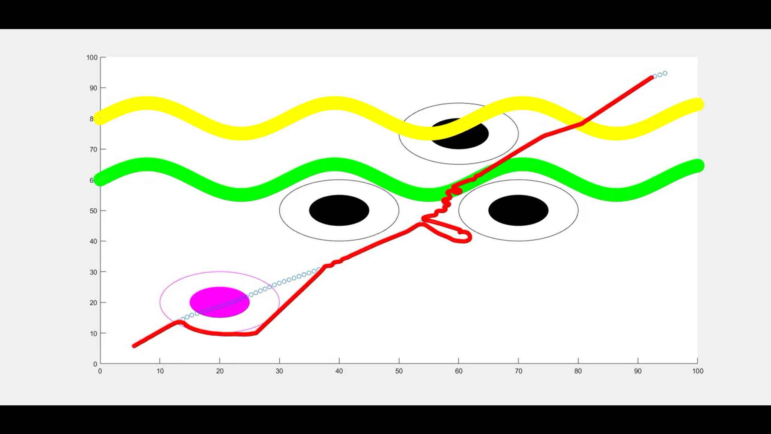
Future Improvement
HJ Reachability analysis is not suitable for real-time computation
Improve algorithm to enable real time path tracking
The current trajectory might have sharp turns when switching controllers
Improve controller switching method
Disturbances is not included in this simulation
Notes:
However, there are still some issues need further improvements. First of all, the HJ Reachability analysis is still too long for real time computation. The algorithm still needs improvement to enable the real time path tracking. Secondly, the current trajectory might have some sharp turns under certain situations, like the figure shows. This might caused by the hard switching method used to switch between PID and HJ analysis. If a better switching method is applied, ant optimal path can be calculated. Finally, disturbances are not considered in this simulation, and it is unknown that how this can affect the final trajectory.

